Slide 1
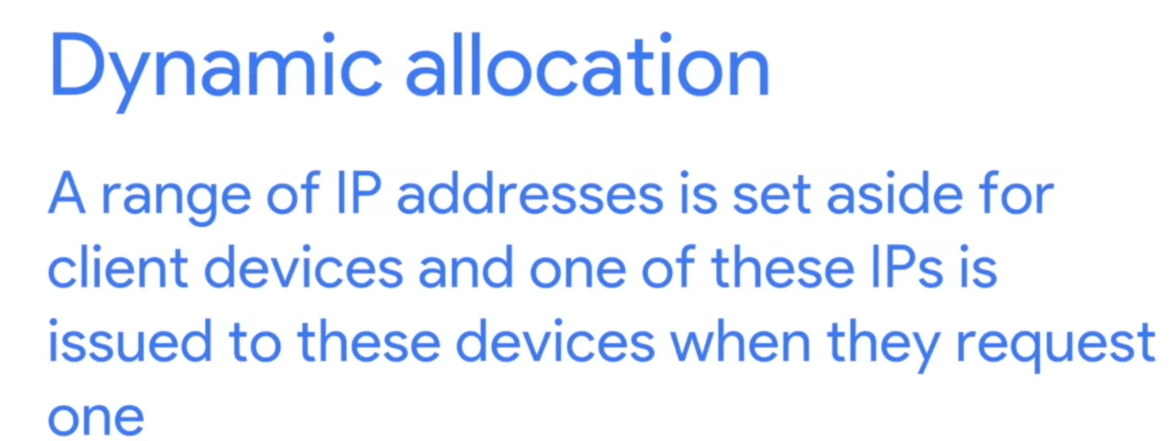
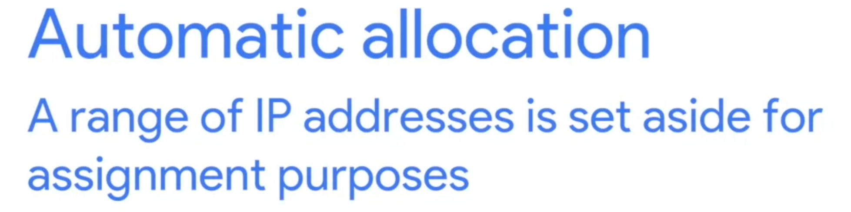
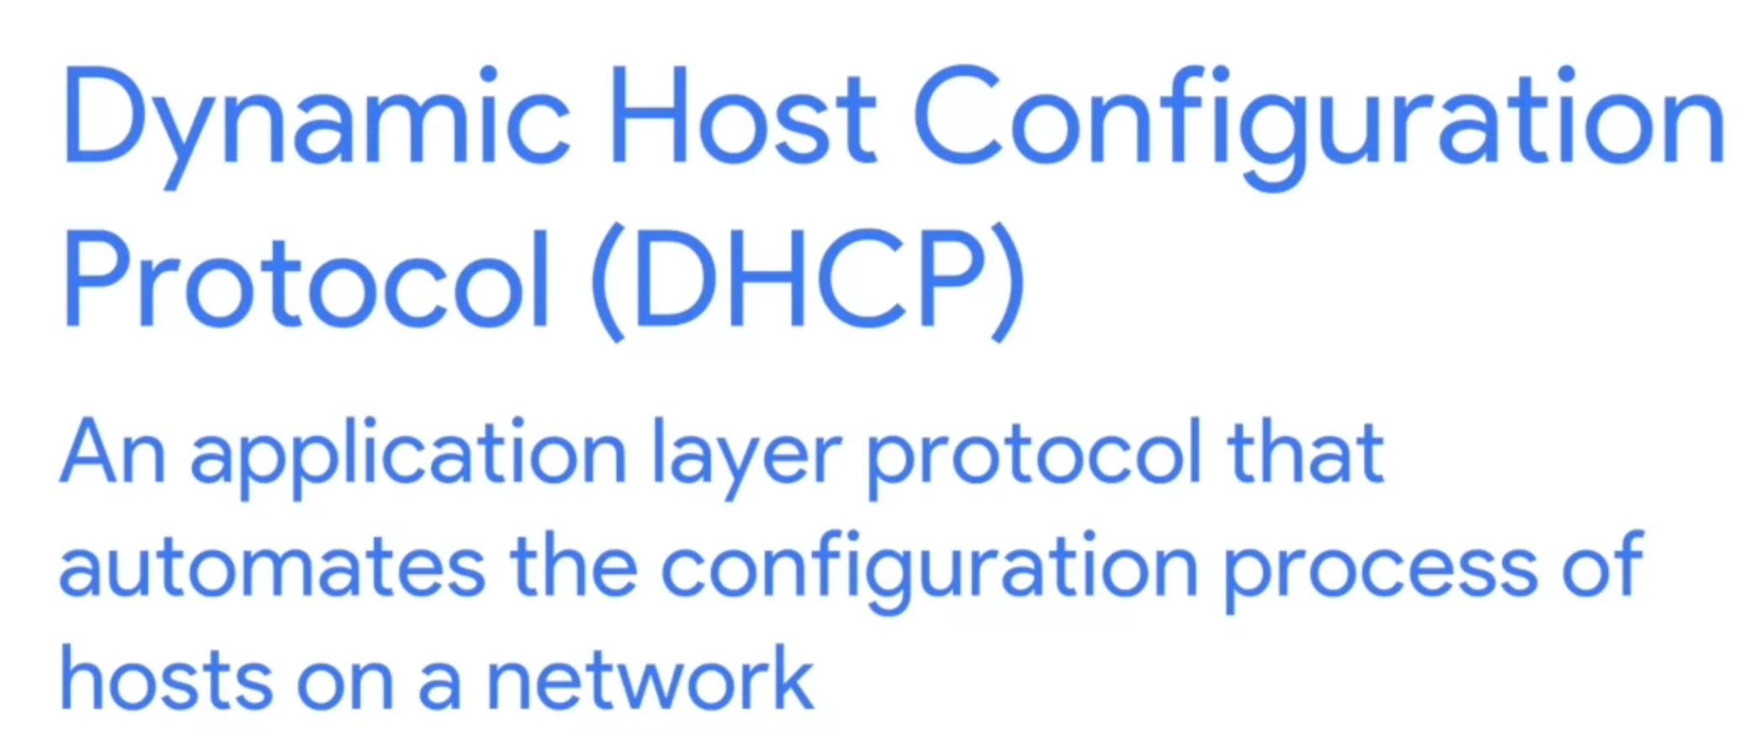
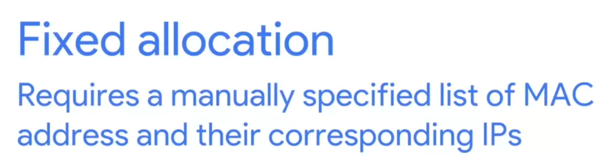
4 things needs to be specified in current network
IP address (unique for each node)
Subnet Mask
Gateway
Name Server (DNS)
DHCP (Dynamic Host Configuration Protocol)
Most of time, the last 3 configuration are same for nodes in the same network. DHCP help us manage the IPs’ information using Dynamic allocation (would keep tract which Ip have been assign to which device)

Slide 2
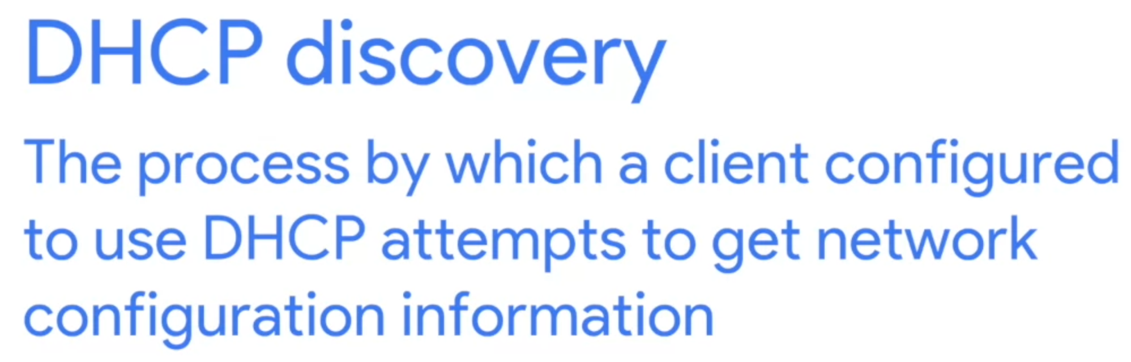
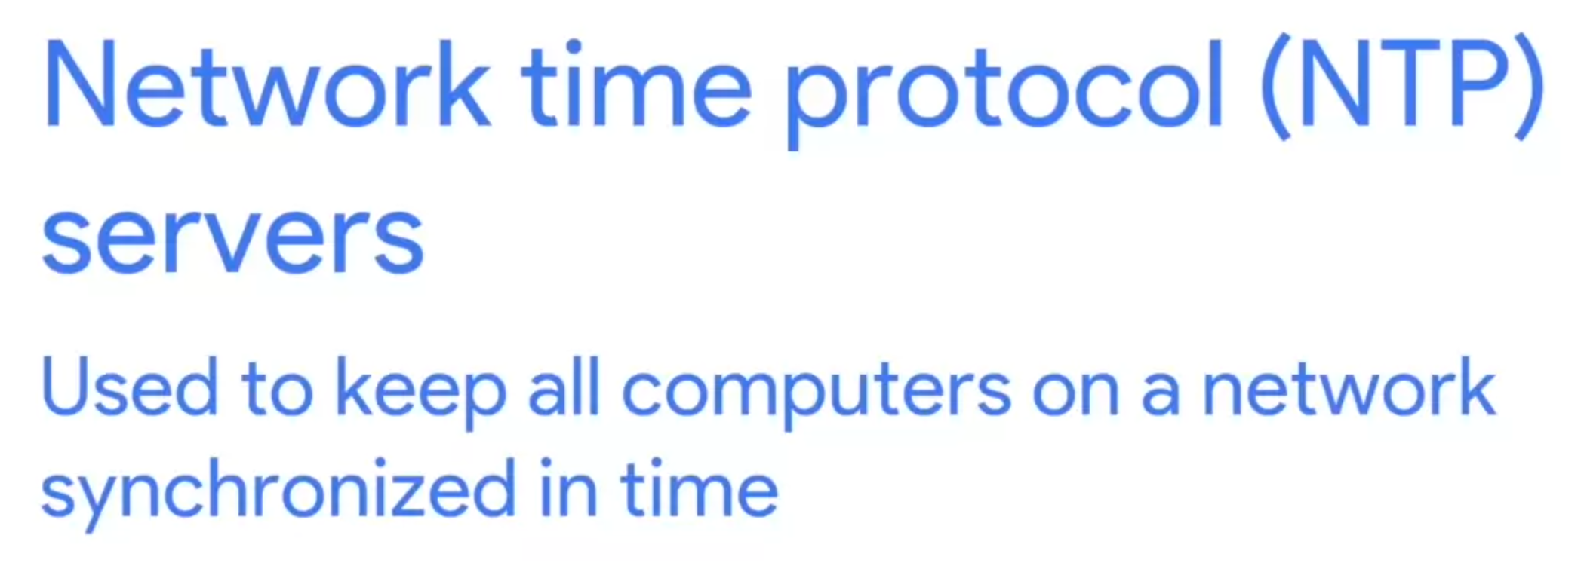
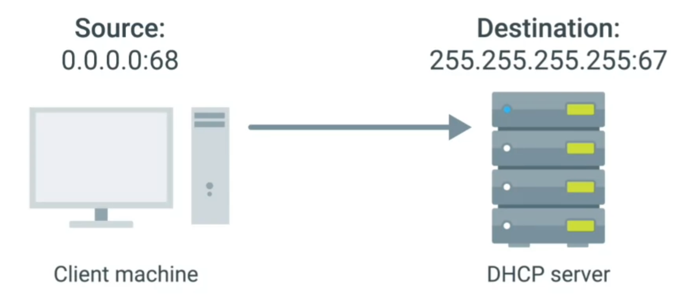
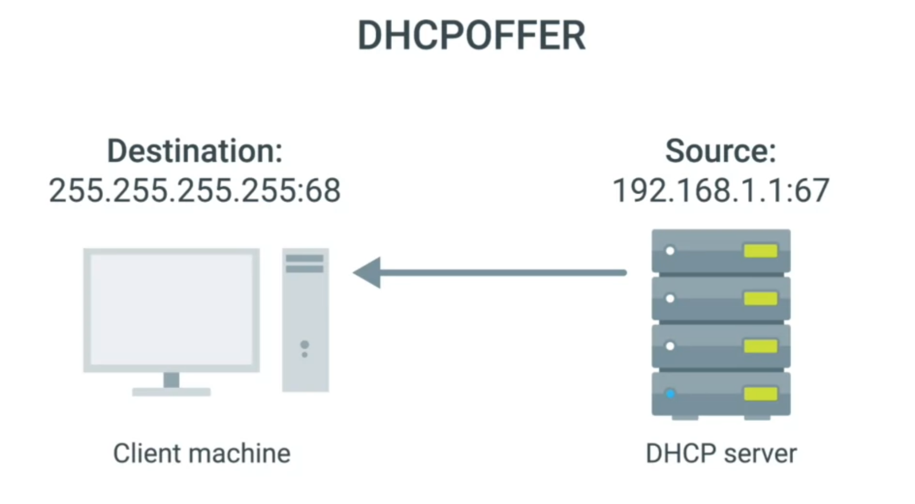
2. After receive the message, DHCP Server Exam it’s own configuration, and use either fixed or dynamic allocation to set a IP address to client (specific the MAC address)
DHCP Discovery Steps
1. Send the discovery message (broadcast, UDP)

Slide 3
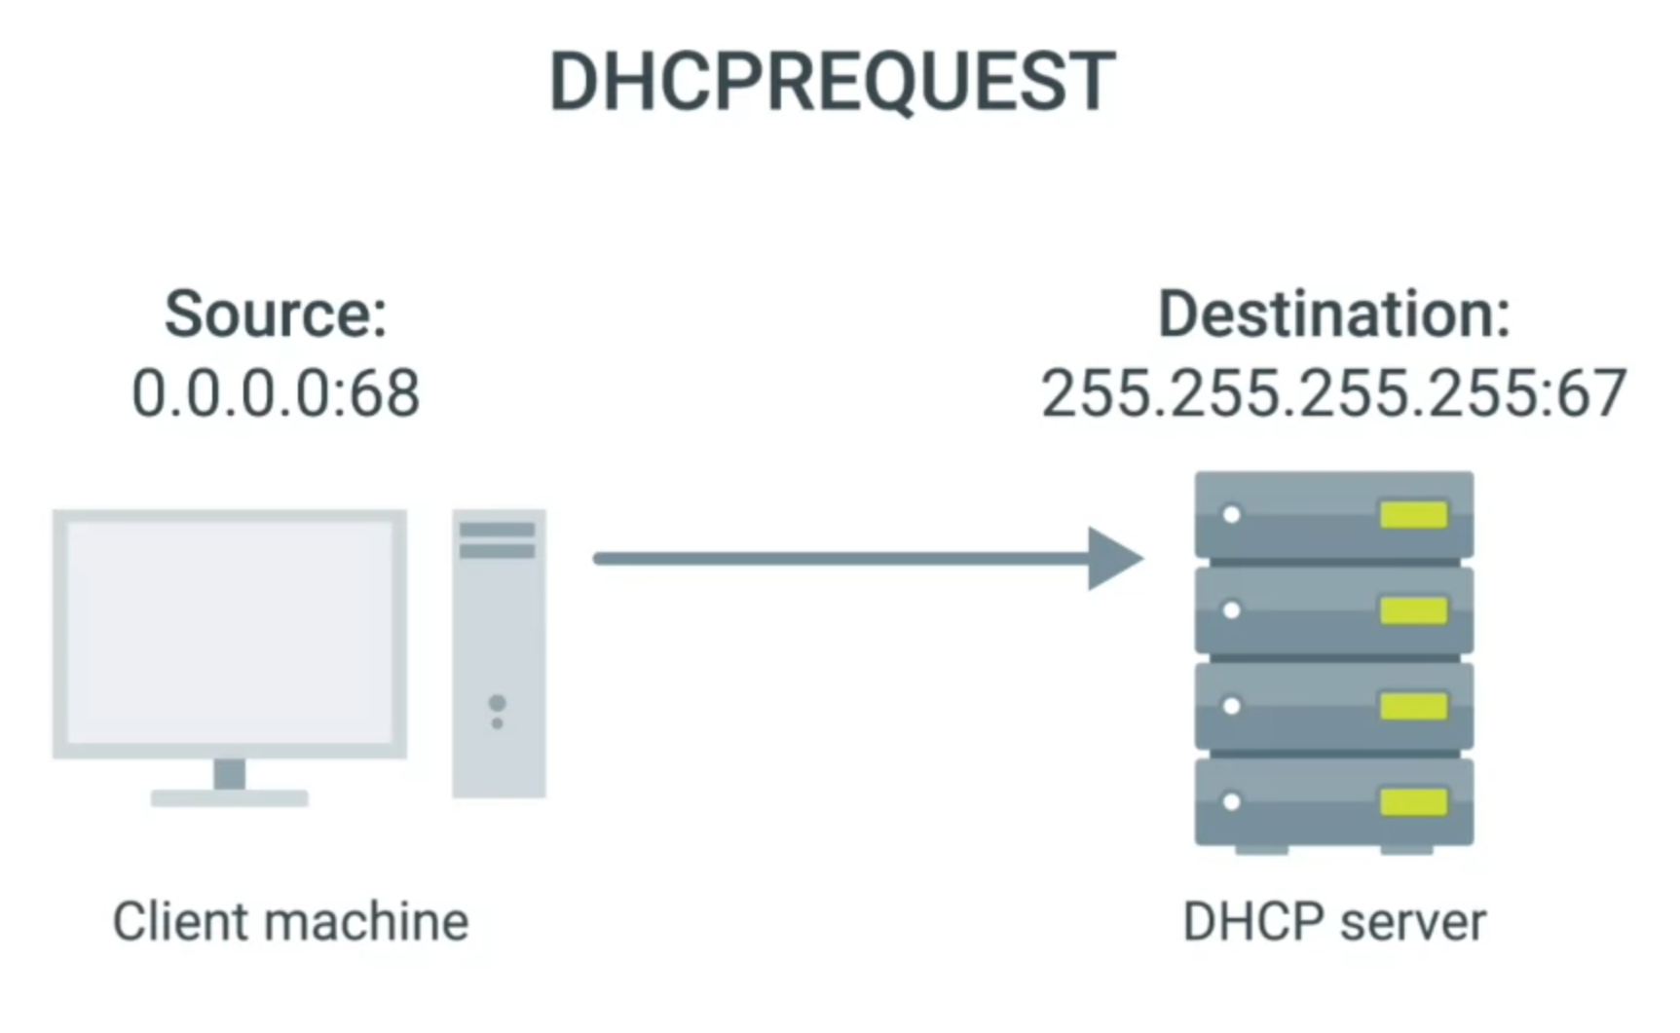
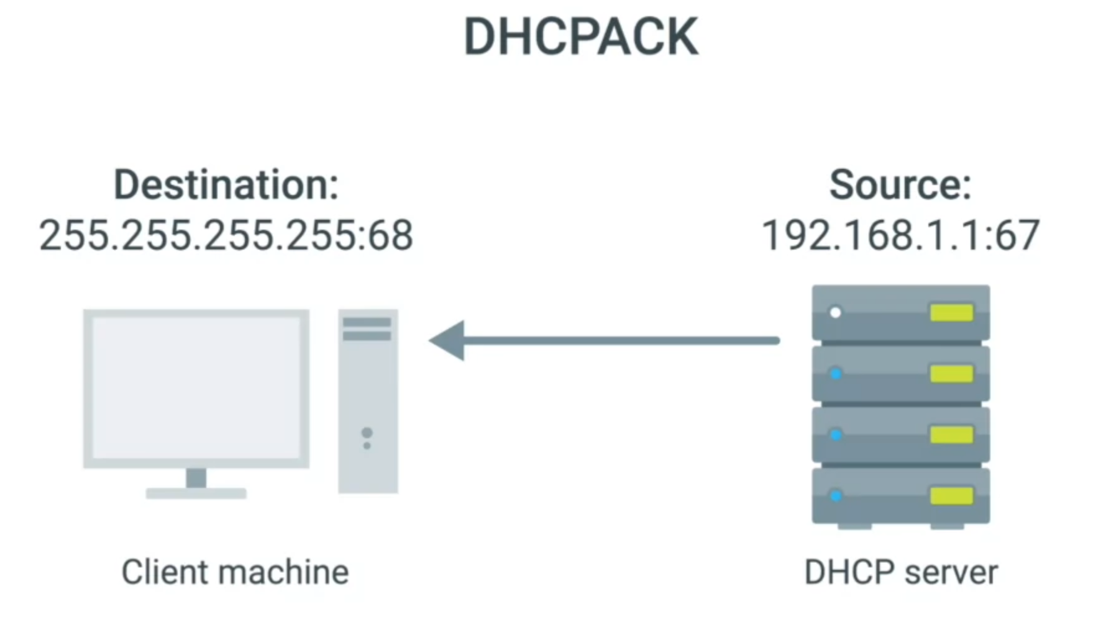
3. Client send a DHCP Request to confirm the offer from DHCP Server
4. DHCP send the acknowledge message to Client Server

Slide 4
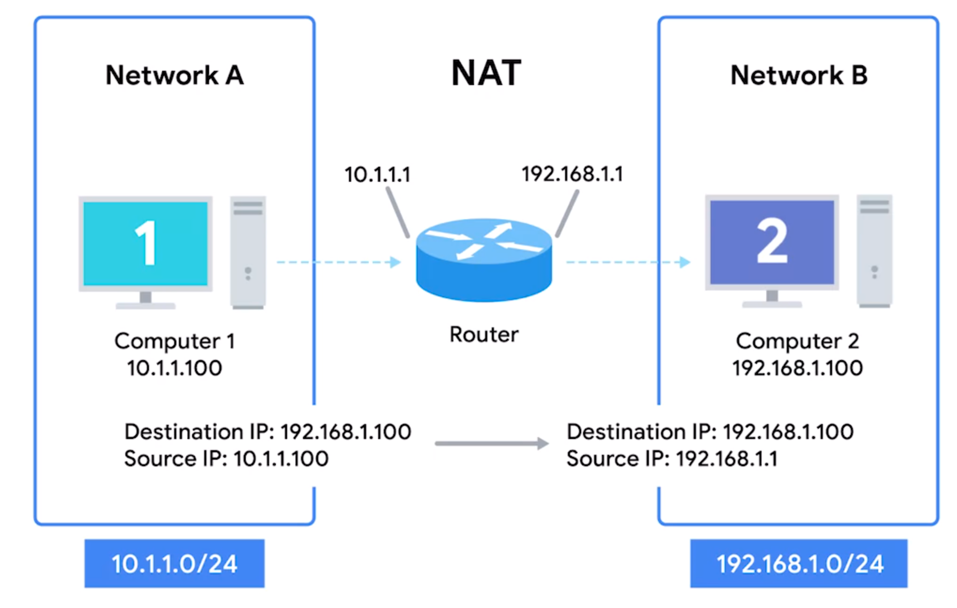
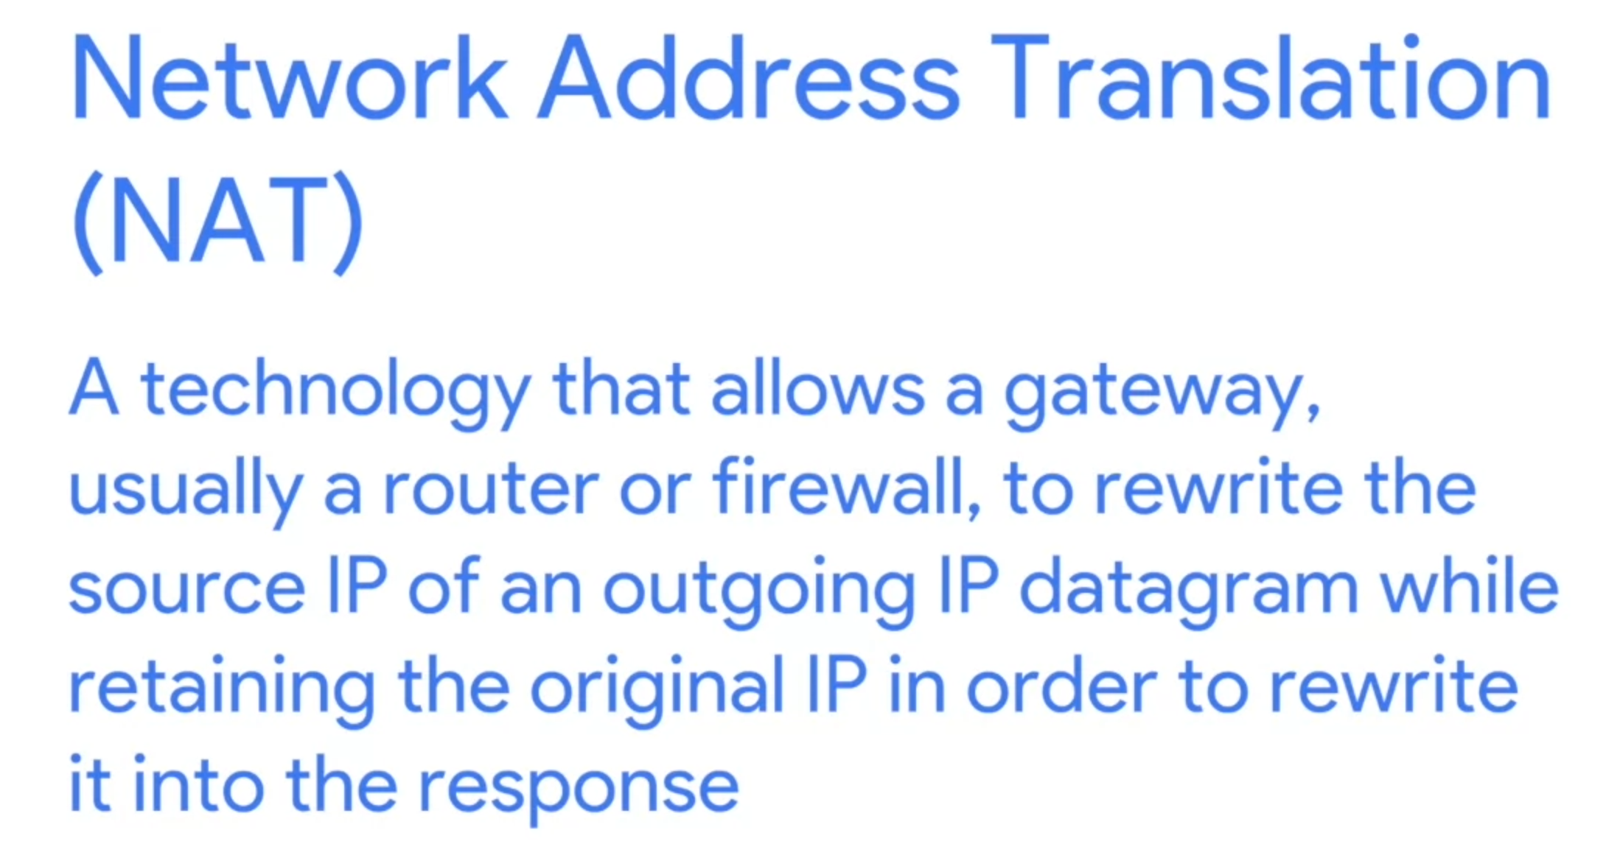
Network Address Translation (NAT)
It’s a Techniques instead of a defined standard (DNS,DHCP).
The following example is, hiding IP of Computer 1 to Computer 2, it’s called IP Masquerading
One to Many NAT: Transfer all outside IP datagram to Computer1 to Router to Computer1, therefore, the Computer 1’s IP is invisible for outside.

Slide 5
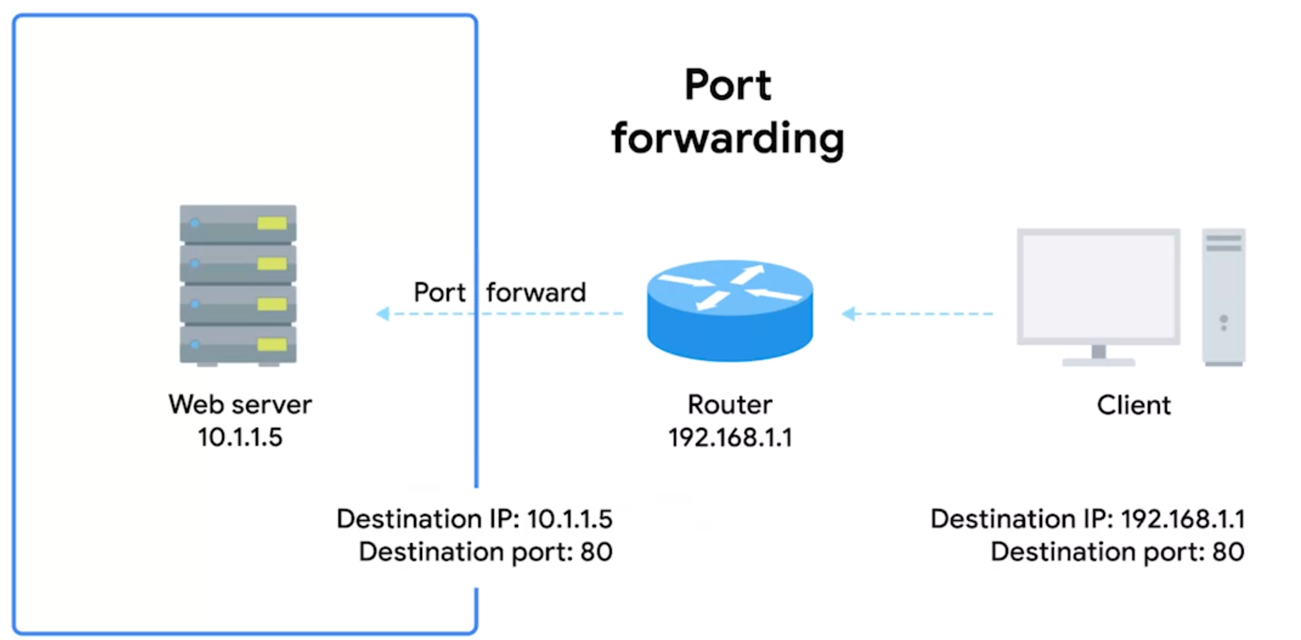
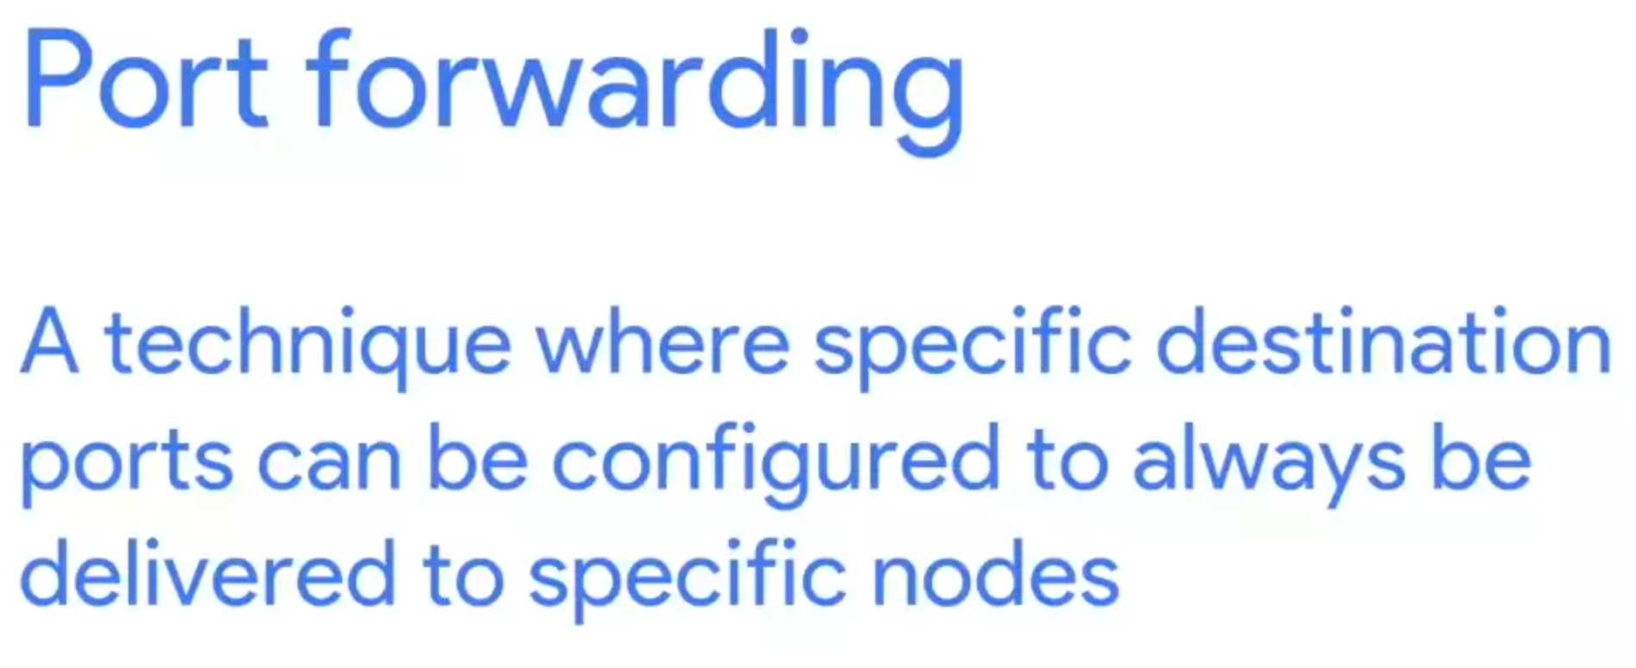
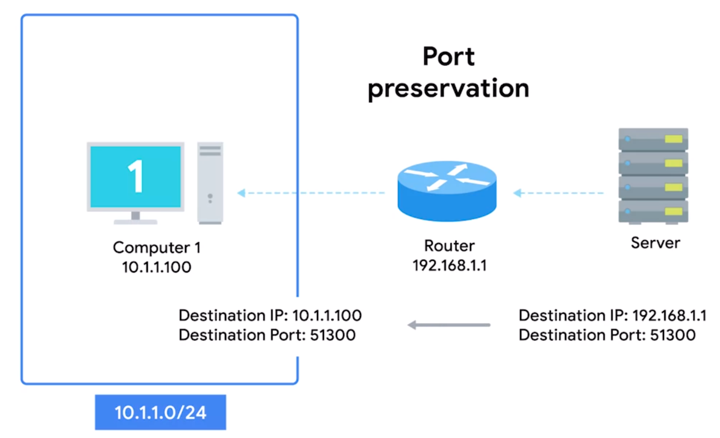
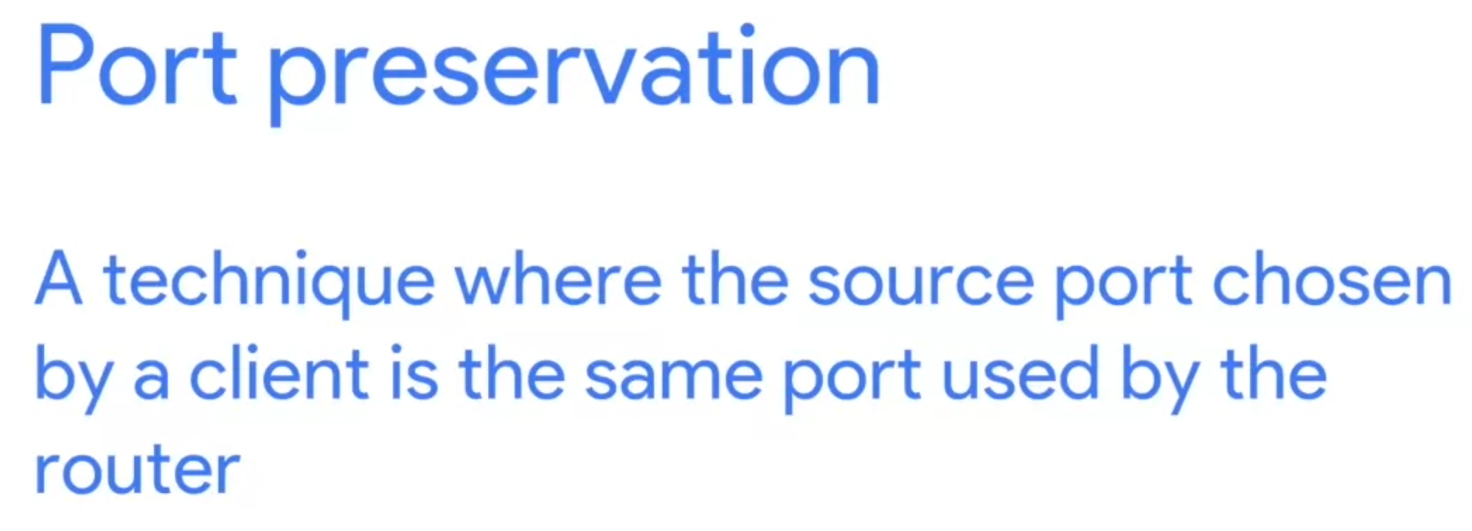

Slide 6
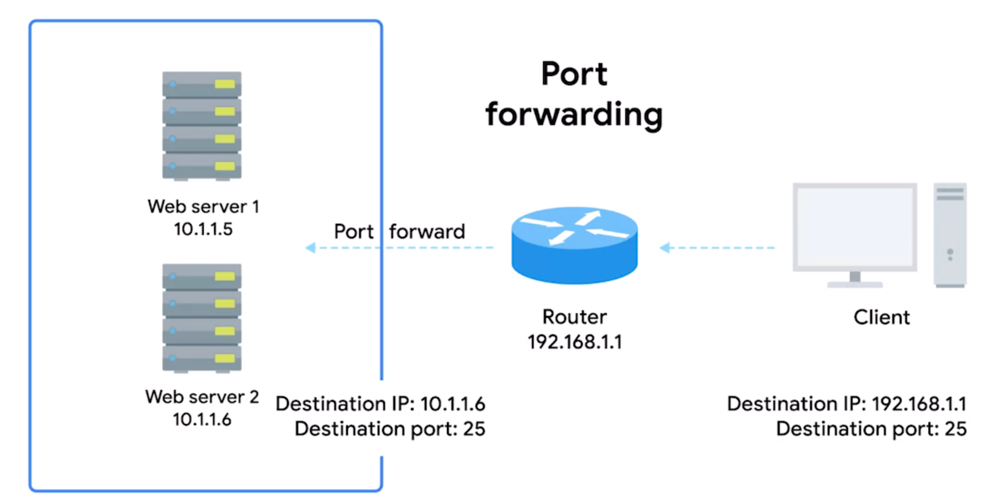
NAT (Port forwarding) can be used to manage two separate server (like webserver and mail server) under the same organization. For outbound client, we do not need to know the IP address of those two server, instead, the Port forwarding would transfer the income data to corresponding server using the port

Slide 7
Supplemental Reading forIPv4 Address Exhaustion
The IANA (Internet Assigned Numbers Authority) has been in charge of distributing IP addresses since 1988. Since that time, the internet has expanded at an incredible rate! The 4.2 billion possible IPv4 addresses have almost run out, as it’s long been predicted.
For some time now, the IANA has primarily been responsible for assigning address blocks to the five regional internet registries or RIRs. The five RIRs are:
AFRINIC, which serves the continent of Africa
ARIN, which serves the United States, Canada and parts of the Caribbean
APNIC, which is responsible for most of Asia, Australia and New Zealand and Pacific Island nations
LACNIC, which covers Central and South America and any parts of the Caribbean not covered by ARIN
RIPE, which serves Europe, Russia,the Middle East, and portions of Central Asia
These five RIRs have been responsible for assigning IP address blocks to organizations within their geographic areas and most have already run out. The IANA assigned the last unallocated /8 network blocks to various RIRs on February 3rd, 2011. Then on April 2011, APNIC reached its final /8 of addresses. RIPE was next, in September of 2012. LACNIC reached its final /10 in June 2014. ARIN exhausted its list of free IPv4 addresses in September 2015. Only AFRINIC has some IPs left.
Wikipedia has a great article all about IPv4 exhaustion and the timelines involved.

Slide 8
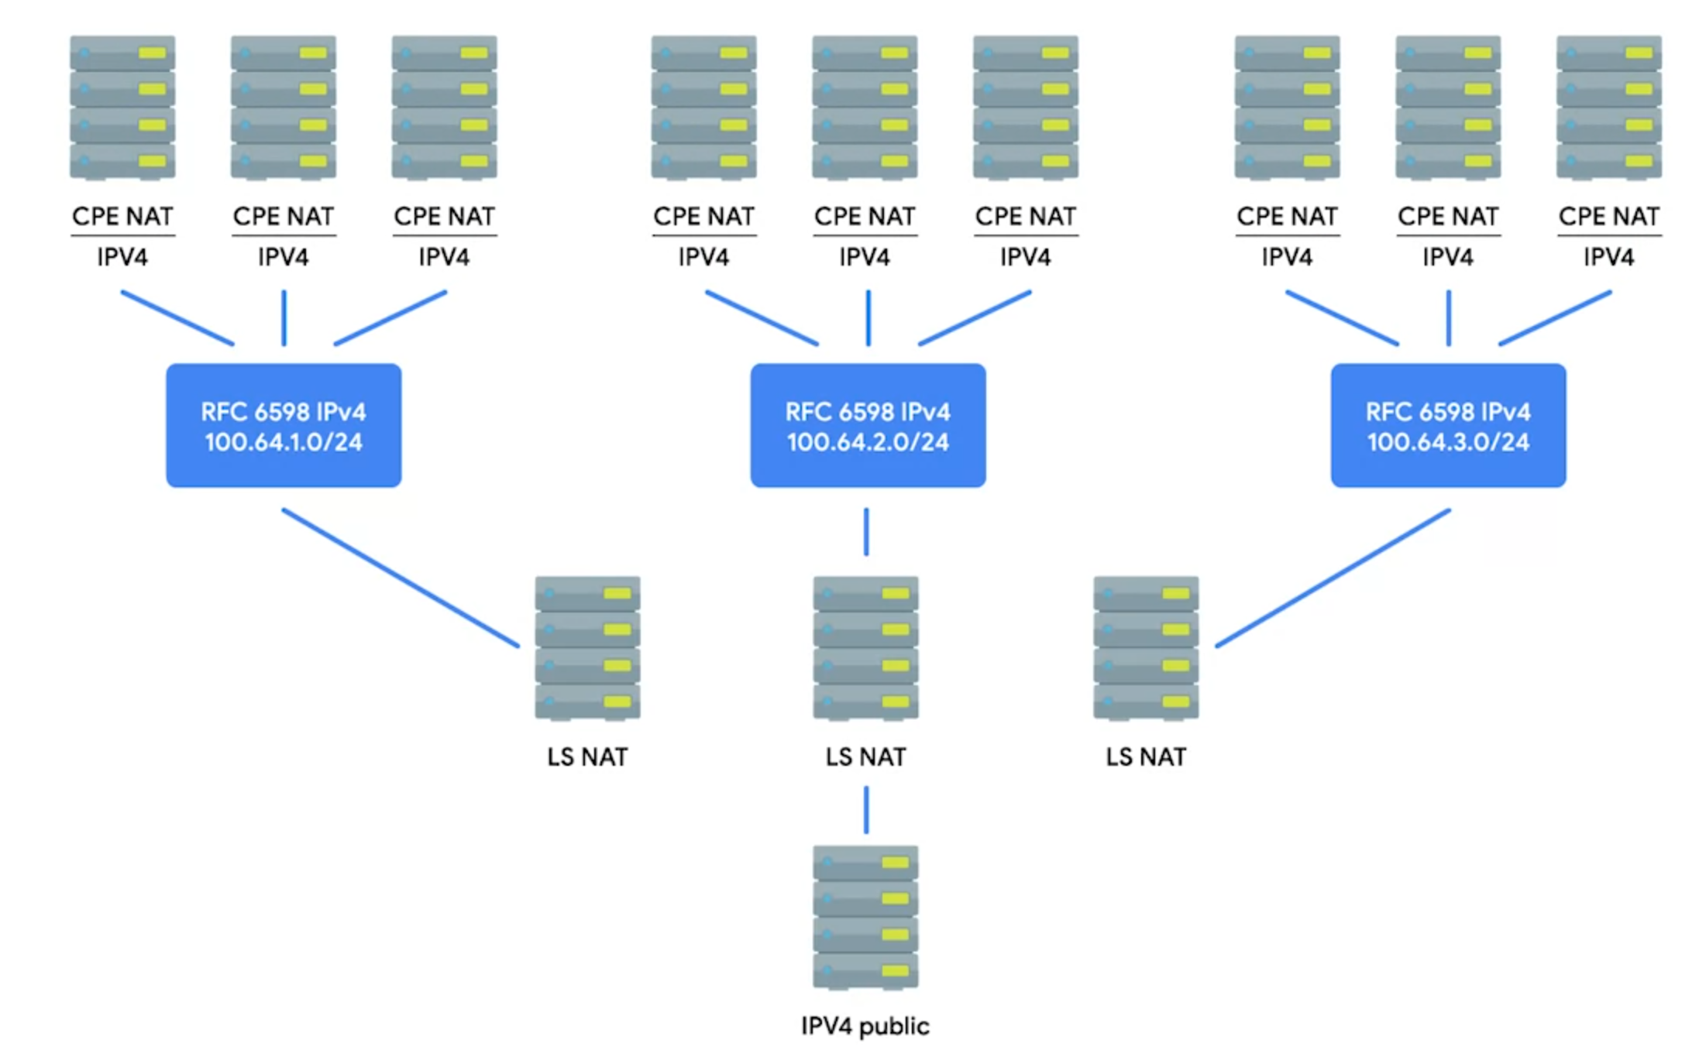
IPv4 address has ran out. Before implement IPv6 worldwide (it takes time), the solution is, use no-routable address space to host those machines, and use NAT to transfer outside datagram to them

